Slide 1
PROJECT REPORT

Slide 2
Make A Shoe Responsive
E-Commerce Websit Design
Using HTML CSS And JAVASCRIPT From Scratch

Slide 3
TEAM MEMBERS
Team leader:GORLA BHAVANIREDDY-SBP0008327
Gorla BhavaniReddy - SBAP0008327
Gudipati Vandanasai - SBAP0008328
Jampula Manasa - SBAP0008329
Kanama Nandini - SBAP0008331
Kchaitanya -SBAP0008332

Slide 4
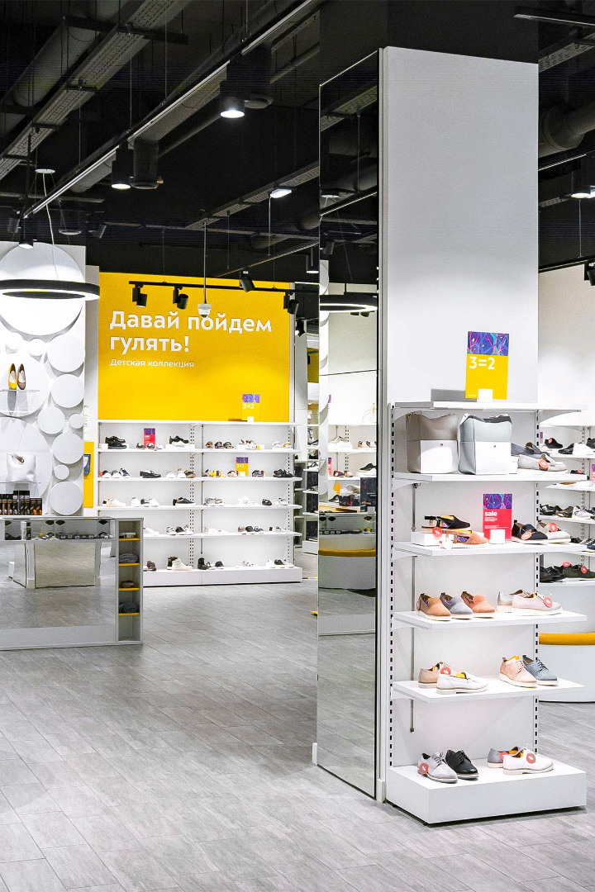

How To Make A Shoe Responsive E-Commerce Website Design Using HTML CSS And JAVASCRIPT From Scratch
In this presentation, we will go step by step through the process of designing a responsive e-commerce website for a shoe store. By the end, you'll have the skills to create a website that is visually appealing and user-friendly.

Slide 5

Why Responsive Design Is Important
1
Mobile Usage 📱
2
Improved User Experience 😊
The majority of internet usage is now on mobile devices, so it's important to make sure your website looks good on all screen sizes.
Responsive design allows for a seamless and intuitive user experience, making it easier for users to find what they're looking for.
3
Increased Conversions 💰
A responsive website can lead to increased conversions and sales, as users are more likely to make a purchase if the website is easy to use.

Slide 6

Overview of the Presentation
In this presentation, we will cover everything you need to know to design a responsive e-commerce website for a shoe store. We will start with planning the website and understanding the target audience, move on to designing the website with wireframes and choosing the right colour scheme, and finally apply interactivity with JavaScript to create animations, an image carousel, and a search bar. We will also optimise the website for performance.

Slide 7
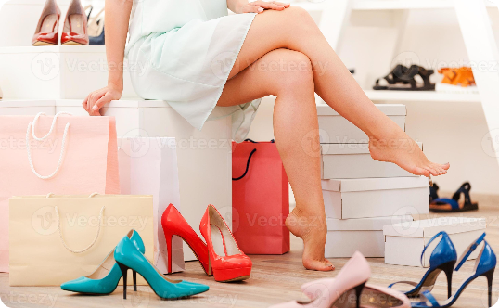
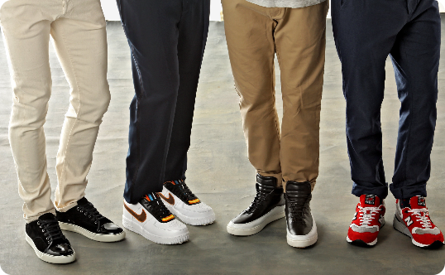

Understanding the Target Audience
Demographics
Interests
Lifestyle
Our target audience is predominantly young (18-40) and female.
Our target audience is interested in fashion and value comfort and style in their footwear.
Our target audience is active and enjoys outdoor activities.

Slide 8
Defining Website Goals and Features
Key Goals 🥅
Key Features 🎨
Provide a visually appealing and intuitive user experience. Increase sales and conversions.
Image carousel, search bar, easy navigation, product categorisation, and customer reviews.

Slide 9
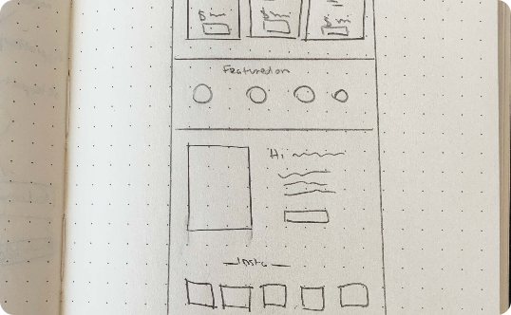
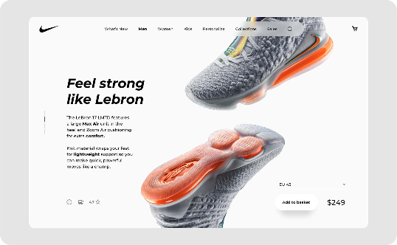
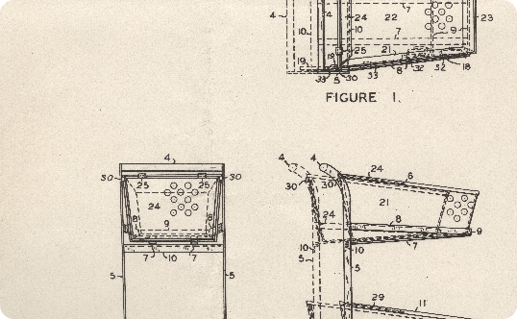
Creating Wireframes
Homepage
Product Page
Cart and Checkout
The homepage features a large hero image, featured products, and a search bar.
The product page features product images, a description, reviews, and a call to action.
Users can easily view their cart and proceed to checkout.

Slide 10
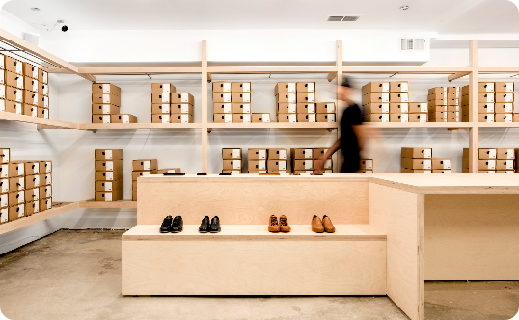
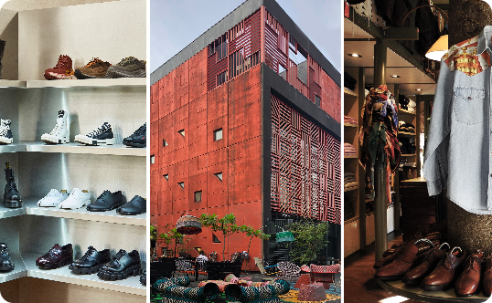
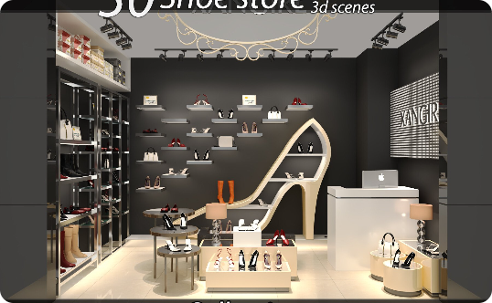
Choosing the Right Colour Scheme
Warm and Inviting
Attention-Grabbing
Modern and Sophisticated
We chose warm hues to create a welcoming and inviting atmosphere.
We added bright accents to grab the user's attention and highlight important elements like buttons and calls to action.
We used a modern, minimalist style to convey sophistication and highlight the high quality of our products.

Slide 11
Applying HTML and CSS
Styling with CSS
We then used CSS to apply styling to our website, including font styles, colours, and layout.
1
2
3
Basic HTML Structure
Adding Images and Content
We started by creating the basic HTML structure for our website, including the header, navigation, and footer.
We then added images and content to our website to make it visually appealing and informative.

Slide 12

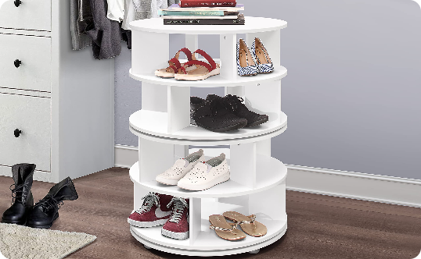
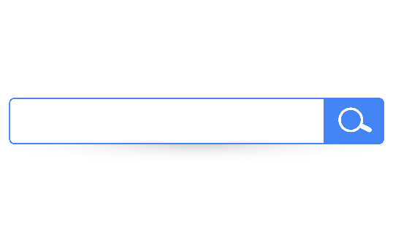
Applying Interactivity with JavaScript
Adding Animations
Creating an Image Carousel
Integrating a Search Bar
We added animations to our website to enhance the user experience and make it more visually engaging.
We used JavaScript to create an image carousel, allowing users to easily browse through our products.
We added a search bar to make it easy for users to find the products they're looking for.

Slide 13
Optimising for Performance
1
Reducing File Sizes
We optimised our images and other files to reduce file size and increase loading speed.
Implementing Lazy Loading
2
We used lazy loading to improve performance by loading images and other elements only when they are needed.
3
Optimising Code
We made sure our code was clean and well-organised to improve performance and make it easier to maintain.

Slide 14

Conclusion
In conclusion, we have covered the essential steps needed to design a responsive e-commerce website for a shoe store. We started with understanding the target audience and defining website goals, then moved on to designing wireframes and choosing the right colour scheme. Finally, we applied interactivity with JavaScript and optimised the website for performance. Thank you for joining me.

